Slide 1
Finding a Successful In-N-Out Burger Location in New York City
Presentation by: Chris Melchione

Slide 2
Introduction
In-N-Out Burger has a 26% market share in the industry, which is the second highest behind Five Guys.
Problem:
There are no locations in New York.
It may be hard to find the best location without the use of Data Science.
The goal of this presentation will be to find the most successful location in New York City to place an In-N-Out Burger.
This will prove to be incredibly valuable to company management as they will be able to save countless hours on planning and meetings.

Slide 3
Data Acquisition and Cleaning
Data for New York City borough detail was sourced from this link:
https://data.cityofnewyork.us/City-Government/New-York-City-Population-by-Borough-1950-2040/xywu-7bv9/data
Foursquare location data was also used simultaneously with this dataset
Data was then cleaned to remove unnecessary tables, and add latitude & longitude columns for further location analysis

Slide 4
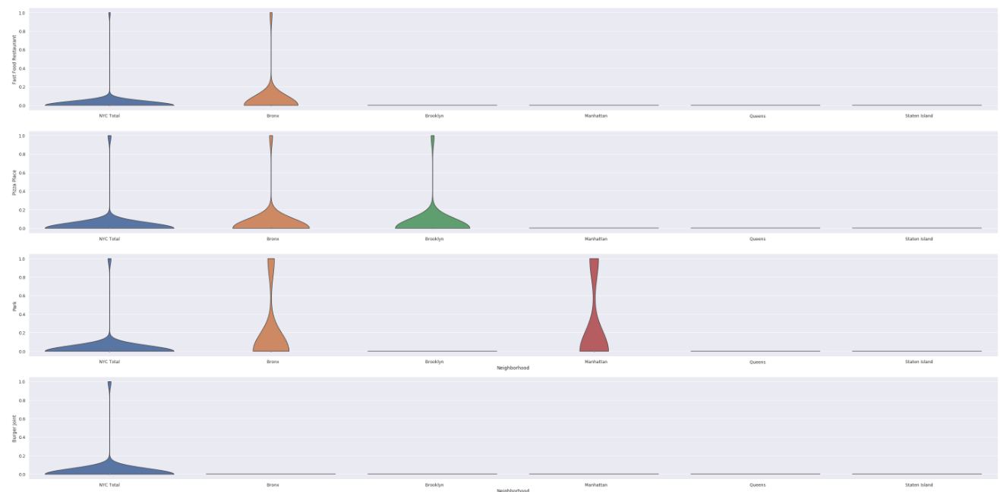
Methodology
Since we found the latitude and longitude of each of the five NYC boroughs, I was able to find the top 100 venues within 500 meters of each boroughs.
I was then able to manipulate the data to breakout the most popular venues in each borough

Slide 5
Results
The violin plot on the previous slide showed that the Bronx had the highest traffic for venues such as pizza places, fast food restaurants, and parks. However, none of the boroughs had a relatively high volume of burger shops.
With this information in mind, it can be inferred that the Bronx would be the best location. This is because there is the highest amount of traffic for fast food and pizza venues, and not a lot of burger joints, thus implying that if there were burger joints, they would be successful.

Slide 6
Discussion
It makes sense that any delicious food store would thrive in a bustling place like New York City. However, the data provides valuable insights on how to potentially maximize the profits.
It is important to note that there is no definitive correct answer based on this data alone. It is still dependent on the industry itself and the way management handles business.

Slide 7
Conclusion
There are countless numbers of ways this analysis could have been performed, which is the beauty of data science.
The Bronx would be a successful borough to place an In-N-Out Burger.
This analysis is a starting point rather than an end point. This gives management an accelerated head start rather than having to spend hours on research, borough visits, and strategizing.

